Slide 1

Java for Beginners
University Greenwich
Computing At School
DASCO
Chris Coetzee

Slide 2
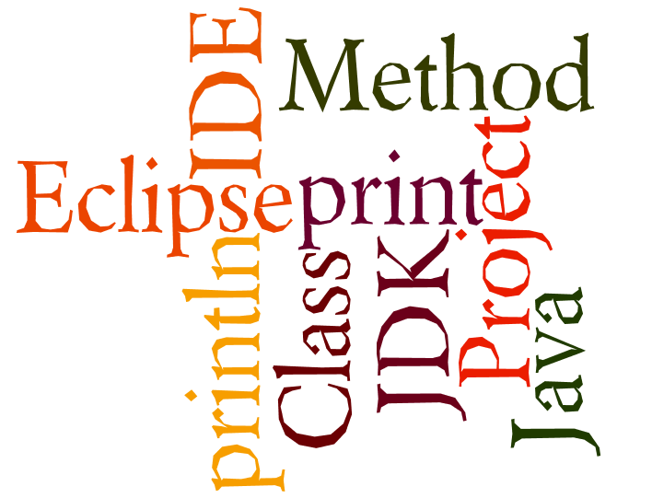
What do you learn last time?
Wordle.org

Slide 3
3 Laws of Java
Every line ends with a ; unless the next symbol is a {
Every { has a }
Classes start with capital letters, methods and variables start with lower case letters

Slide 4

Java’s structure
Java programs are called ‘classes’
They exist inside a container called a project
All classes have at least one method called main()
Project: CheeseCake
Class: CheeseCake
Method: main()
We write our ‘code’ here

Slide 5
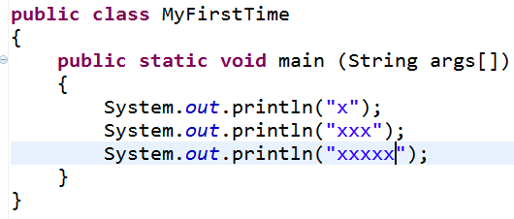
Java class example
Class name
Main method

Slide 6
Levels of Java coding
1: Syntax, laws, variables, output
2: Input, calculations, String manipulation
3: Selection (IF-ELSE)
4: Iteration/Loops (FOR/WHILE)
5: Complex algorithms
6: Arrays
7: File management
8: Methods
9: Objects and classes
10: Graphical user interface elements

Slide 7
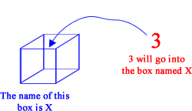
Variables vs. Value
A variable is like a box
What is inside the box can change or ‘vary’
The ‘thing’ inside the box is the value

Slide 8

5 types of variables
double
boolean
int
char
String

Slide 9
Why not have just 1 type?
Only type big enough to cope with sentences is Strings
Strings are BIG compared with booleans/ints
To save space, we only use the box type that is “just big enough” to contain the value we want.
Less waste = faster programs!

Slide 10
Strings: “cat” “DA1 2HW”
double
boolean
int
char
String

Slide 11
int: 23 0 -98 39290 -321
double
boolean
int
char
String

Slide 12
double: 1.2 -5.93 3.3333
double
boolean
int
char
String

Slide 13
boolean: true / false
double
boolean
int
char
String

Slide 14
char: ‘a’ ‘3’ ‘@’ ‘A’ ‘ ’
double
boolean
int
char
String

Slide 15
What data type is each of the following?
double
-9
4.5
chicken
false
%
£ 2.90
The cat is hungry now.
192.168.1.190
boolean
int
char
String

Slide 16
Declare vs. Instantiate
_{Declare}
int number;
number = 3;
int number = 3;
_{Instantiate}
All in one!

Slide 17
Strings
_{Declare}
String name;
name = “Joe”;
String name = “Joe”;
_{Instantiate}
All in one!

Slide 18
char
_{Declare}
char letter;
letter = ‘a’;
char letter = ‘a’;
_{Instantiate}
All in one!

Slide 19
double
_{Declare}
double price;
price = 2.99;
double price = 2.99;
_{Instantiate}
All in one!

Slide 20
boolean
_{Declare}
boolean fit;
fit = true;
boolean fit = true;
_{Instantiate}
All in one!

Slide 21
Be careful!
true vs “true”
“a” vs ‘a’
“4” vs 4
“2.99” vs 2.99
+ vs ‘+’ vs “+”
Note! Strings cannot do calculations

Slide 22
What does this do?
int num;
num = 23;
System.out.println(23);
System.out.println(num);
System.out.println(“23”);
Output
23
23
23

Slide 23
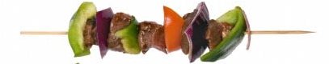
Combining values and variables
int num1 = 5;
int num2 = 10;
System.out.println(num1+num2);
System.out.println(num1+” + ”+num2);
Output
15
5 + 10

Slide 24
What went wrong?!
String number = “2”;
int zombie = 4;
System.out.println(number+number);
System.out.println(zombie+zombie);
Output
22
8

